Slide 1
ALJABAR LINIER
Dr. RETNO KUSUMANINGRUM, S.SI., M.Kom.
Introduction

Slide 2

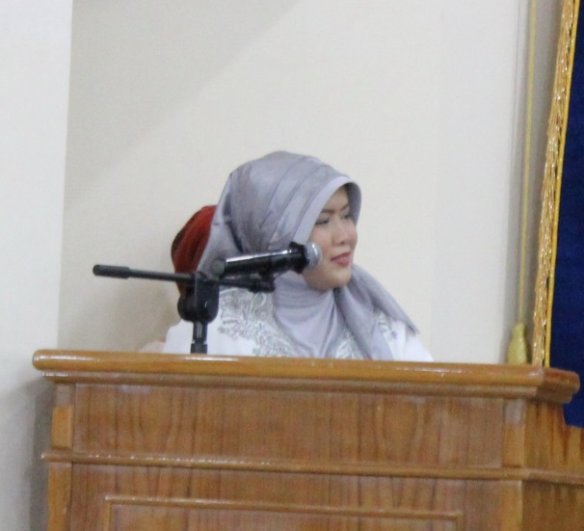

Email : retno@if.undip.ac.id
No. HP : +62 812 98 55 3236
Pendidikan :
S1 Matematika UNDIP
S2 Magister Ilmu Komputer UI
S3 Doktor Ilmu Komputer UI
Sandwich Like Program 2012 – University of Reading, UK

Slide 3
What is Linear Algebra?

Slide 4
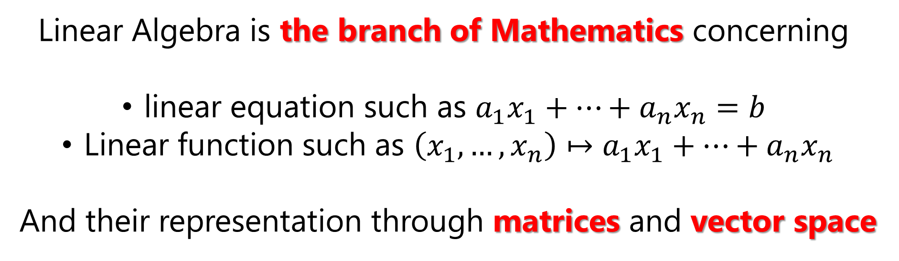
Linear Algebra is the branch of Mathematics concerning
linear equation such as $a_{1}x_{1}+…+a_{n}x_{n}=b$
Linear function such as $\left(x_{1},…,x_{n}\right)↦a_{1}x_{1}+…+a_{n}x_{n}$
And their representation through matrices and vector space

Slide 5
As a Computer Scientist,
Why do we need to study
linear algebra?

Slide 6
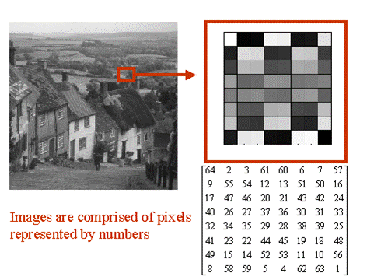
LINEAR ALGEBRA IN COMPUTER VISION
All images can be represented as matrix format
In the case of a 256x256 pixel gray scale image, the image is stored as a 256x256 matrix, with each element of the matrix being a whole number ranging from 0 (for black) to 225 (for white)
The color pictures for example in RGB scale have three values for each pixel, which means it becomes a three dimensional array.
See Whiteboard for Detail Information!

Slide 7
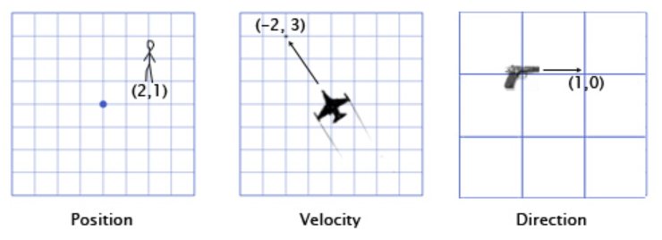
LINEAR ALGEBRA IN COMPUTER GAMING
In games, vectors are used to store positions, directions, and velocities. Here are some 2-Dimensional examples:
The position vector indicates that the man is standing two meters east of the origin, and one meter north.
The velocity vector shows that in one minute, the plane moves three kilometers up, and two to the left.
The direction vector tells us that the pistol is pointing to the right.

Slide 8
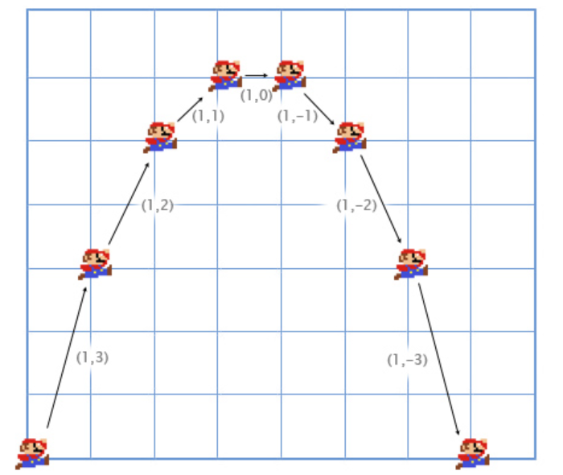
Example of Mario jumping.
He starts at position (0,0). As he starts the jump, his velocity is (1,3) -- he is moving upwards quickly, but also to the right. His acceleration throughout is (0,-1), because gravity is pulling him downwards. Here is what his jump looks like over the course of seven more frames. The black text specifies his velocity for each frame.

Slide 9




LINEAR ALGEBRA IN NATURAL LANGUAGE PROCESSING
...
Bag of Words
See Whiteboard !

Slide 10
LINEAR ALGEBRA IN CRYPTOGRAPHY
Encryption and decryption require the use of some secret information, usually referred to as a key
Example let the message be:
PREPARE TO NEGOTIATE
We assign a number for each letter of alphabet
The message becomes
P | R | E | P | A | R | E | * | T | O | * | N | E | G | O | T | I | A | T | E
16 | 18 | 5 | 16 | 1 | 18 | 5 | 27 | 20 | 15 | 27 | 14 | 5 | 7 | 15 | 20 | 9 | 1 | 20 | 5

Slide 11
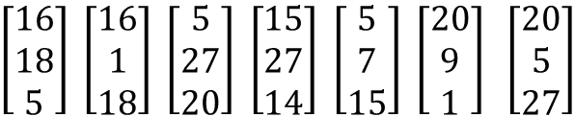
P | R | E | P | A | R | E | * | T | O | * | N | E | G | O | T | I | A | T | E
16 | 18 | 5 | 16 | 1 | 18 | 5 | 27 | 20 | 15 | 27 | 14 | 5 | 7 | 15 | 20 | 9 | 1 | 20 | 5
For example, we are using a $3×3$ matrix, we break the enumerated message above into a sequence of 3 by 1 vectors:
$\left[\begin{matrix}16 \\ 18 \\ 5\end{matrix}\right] \left[\begin{matrix}16 \\ 1 \\ 18\end{matrix}\right] \left[\begin{matrix}5 \\ 27 \\ 20\end{matrix}\right] \left[\begin{matrix}15 \\ 27 \\ 14\end{matrix}\right] \left[\begin{matrix}5 \\ 7 \\ 15\end{matrix}\right] \left[\begin{matrix}20 \\ 9 \\ 1\end{matrix}\right] \left[\begin{matrix}20 \\ 5 \\ 27\end{matrix}\right]$
By multiplying encoding $3×3$ matrix to the message, we will encrypt the message
$$\left[\begin{matrix}−3 & −3 & −4 \\ 0 & 1 & 1 \\ 4 & 3 & 4\end{matrix}\right]\left[\begin{matrix}16 & 16 & 5 \\ 18 & 1 & 27 \\ 1 & 18 & 20\end{matrix} \begin{matrix}15 & 5 & 20 \\ 27 & 7 & 9 \\ 14 & 15 & 20\end{matrix} \begin{matrix}20 \\ 5 \\ 27\end{matrix}\right]=\left[\begin{matrix}−122 & −123 & −176 \\ 23 & 19 & 47 \\ 138 & 139 & 181\end{matrix} \begin{matrix}−182 & −96 & −91 \\ 41 & 22 & 10 \\ 197 & 101 & 111\end{matrix} \begin{matrix}−183 \\ 32 \\ 203\end{matrix}\right]$$
Now, to decrypt the message we have to multiply this matrix to inverse of encoding matrix

Slide 12




Materi
Penilaian
Aturan
Kejujuran

Slide 13
MATERI
Pra – UTS
Post – UTS

Slide 14
MATERI PRE – UTS
Konsep Vektor dan Skalar (Vektor vs Skalar, Operasi Vektor dan Skalar)
Konsep Matriks (Sifat, Jenis, dan Operasi)
Konsep Transformasi Elementer (Transformasi Elementer Baris dan Kolom, Invers Matriks dengan Transformasi Elementer, Ekuivalensi Matriks)
Determinan Matriks (Ekspansi Kofaktor, Sifat Determinan dan Reduksi Baris, Aturan Crammer)
Sistem Persamaan Linier (SPL dengan Inversi dan Transformasi Linier)
Ruang Vektor (Ruang Vektor, Sub Ruang, Ruang Baris dan Ruang Kolom)
Vektor Bebas Linier vs Vektor Bergantung Linier

Slide 15
Materi post – uts
Kombinasi Linier
Basis dan Dimensi Ruang Vektor
Transformasi Linier antar Ruang Vektor, Matriks Ruang Vektor, Perubahan Basis Ruang Vektor
Ortogonalisasi Basis Ruang Vektor
Eigen Value dan Vector
Similaritas Matriks Transformasi Linier
Diagonalisasi Matriks Transformasi Linier

Slide 16
BOOK
Anton, H., Elementary Linear Algebra
Gilbert Strang.2005. Linear Algebra and Its Applications (4ed)

Slide 17
Aturan
Jumlah sks : 3 sks (@ 150 menit)
Jumlah Perkuliahan :
Term 1 : 7 pertemuan + 1 UTS
Term 2 : 7 pertemuan + 1 UAS
Berpakaian rapi, sopan, dan memakai sepatu
Toleransi keterlambatan menit
Keterlambatan pengumpulan tugas dikenakan sanksi berupa pemotongan nilai sebesar 5 poin per hari
Jika anda memiliki alasan yang bisa diterima terkait dengan keterlambatan pengumpulan tugas, maka bisa disampaikan sebelum deadline waktu pengumpulan tugas

Slide 18
Kejujuran
No Plagiarism dalam seluruh komponen penilaian
Apabila ditemukan adanya plagiarism maka nilai akan dikurangi 50%
Tidak diperbolehkan titip absen

Slide 19
Penilaian
Tugas : 30% (incl. Quiz)
UTS : 35%
UAS : 35%
Rentang Nilai Angka | Nilai Huruf | Bobot Nilai Huruf
≥ 80 | A | 4,00
70 – 79,99 | B | 3,00
60 – 69,99 | C | 2,00
51 – 59,99 | D | 1,00
≤ 50,99 | E | 0,00

